Slide 1
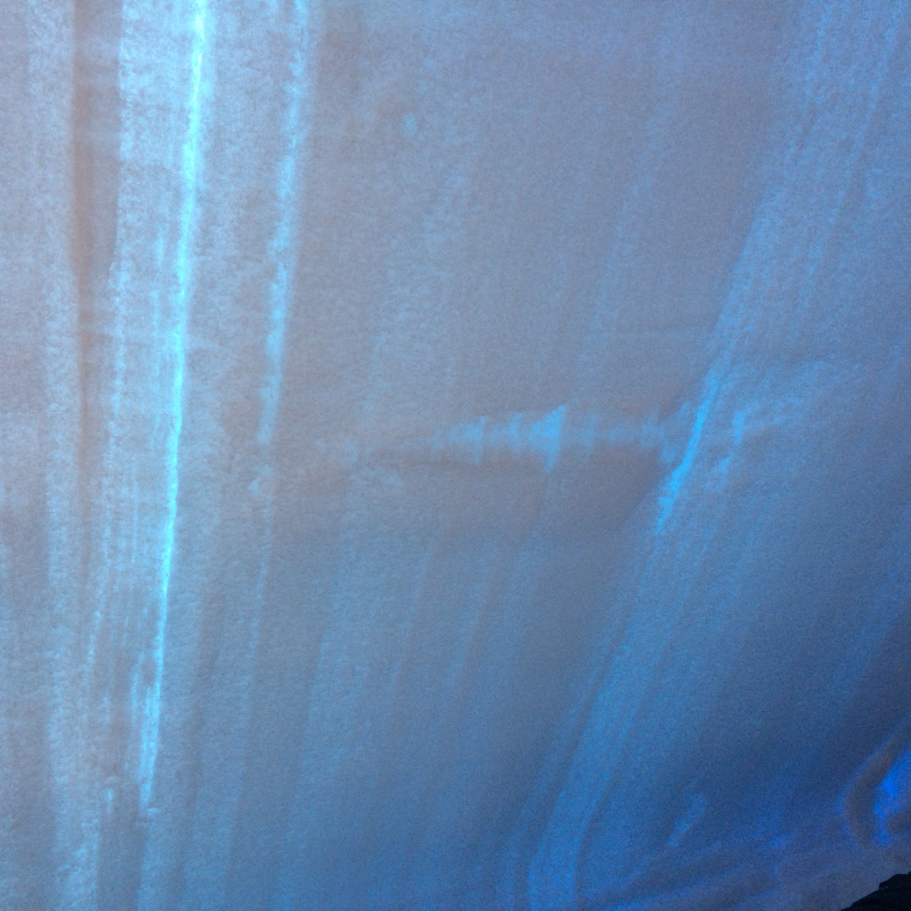
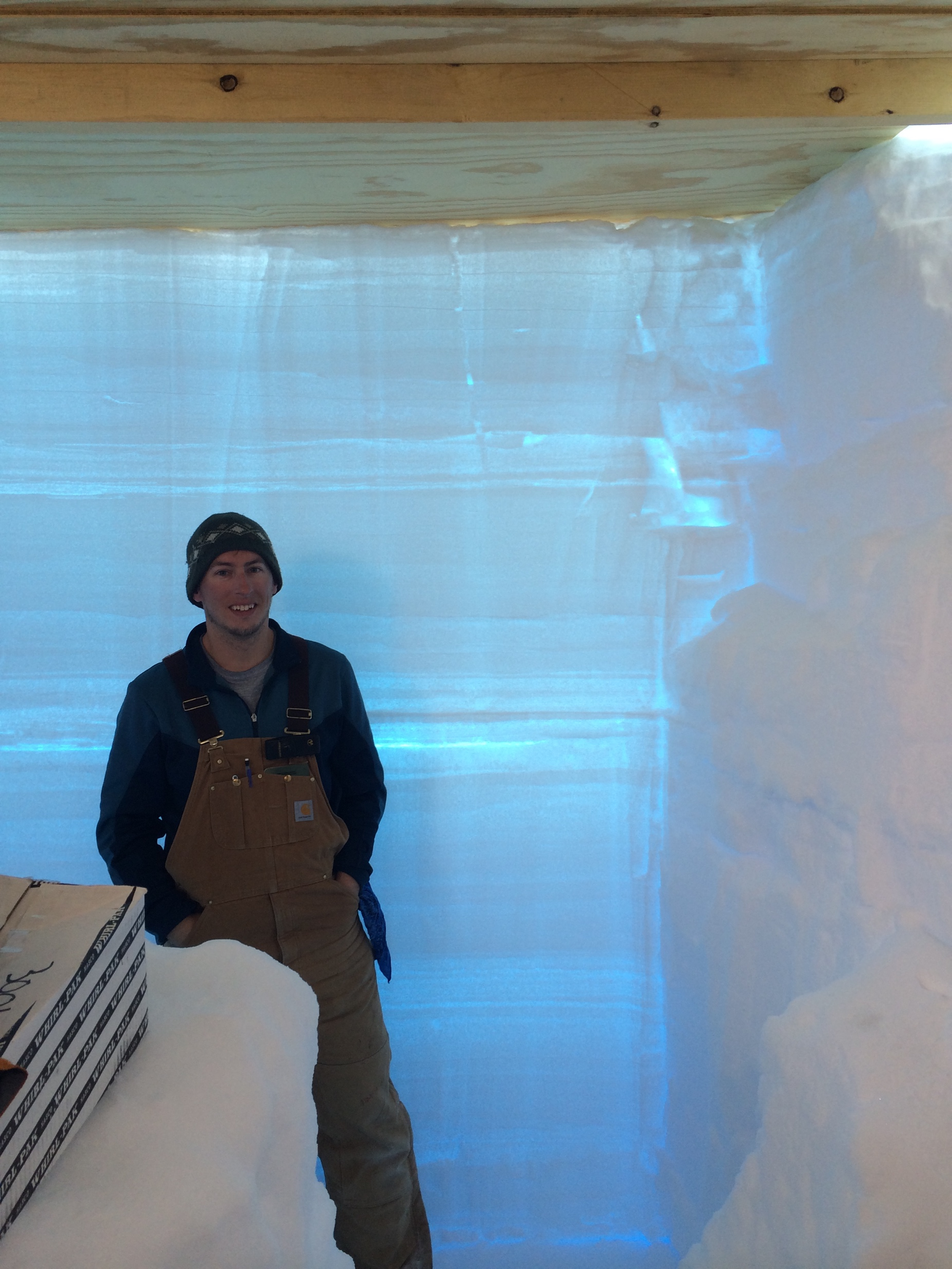
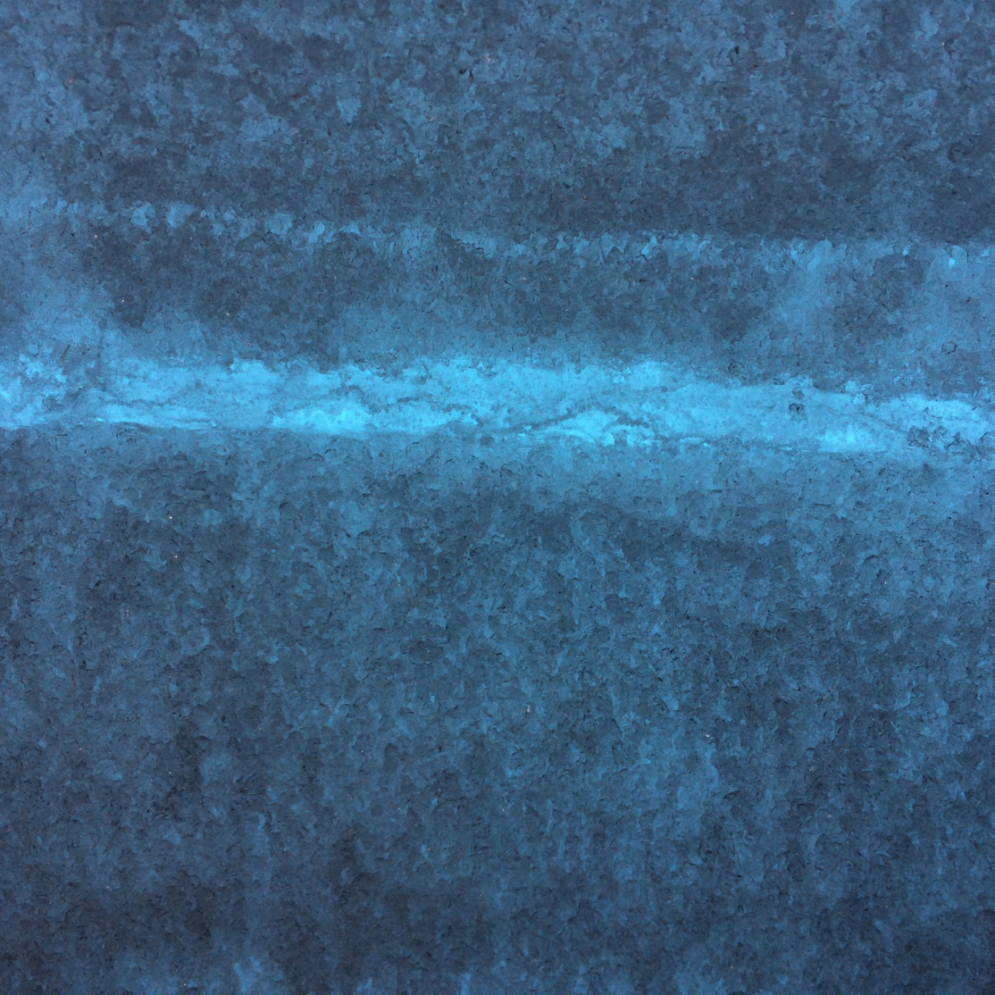
2.5 m backlit snow pit near TAWO
Summit, July 2014
Melt surface
Pit was dug for educational purposes by JSEP group in clean snow and we sampled it after presentations/discussion
Illustrates the complexity of the near-surface snow
Melt layer very obvious
Inter-layer density variability is large compared to compaction
Lots of horizontal spatial variability even across this short transect
Melt drainage
Secondary ice lens
2012 melt layer

Slide 2
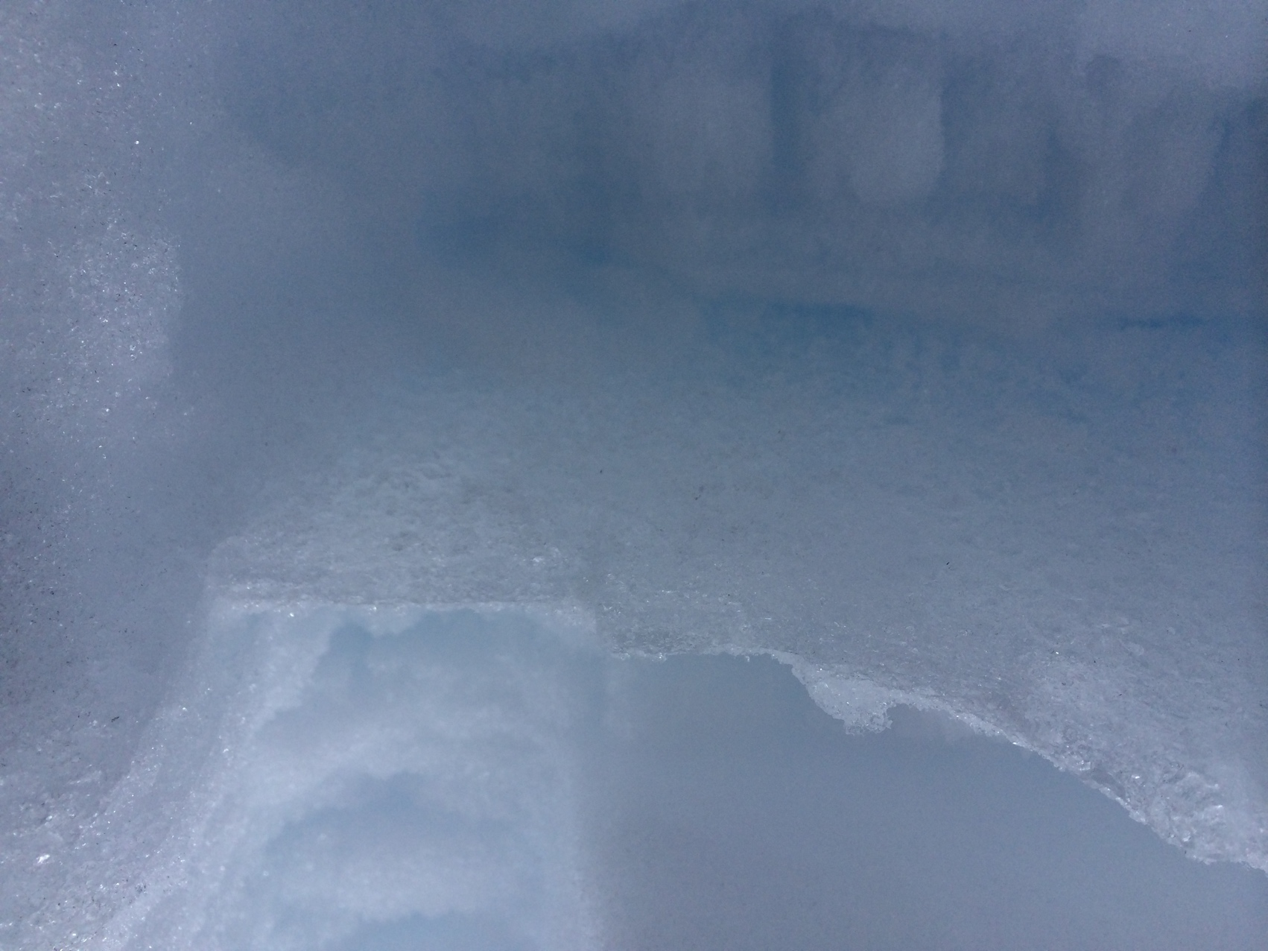
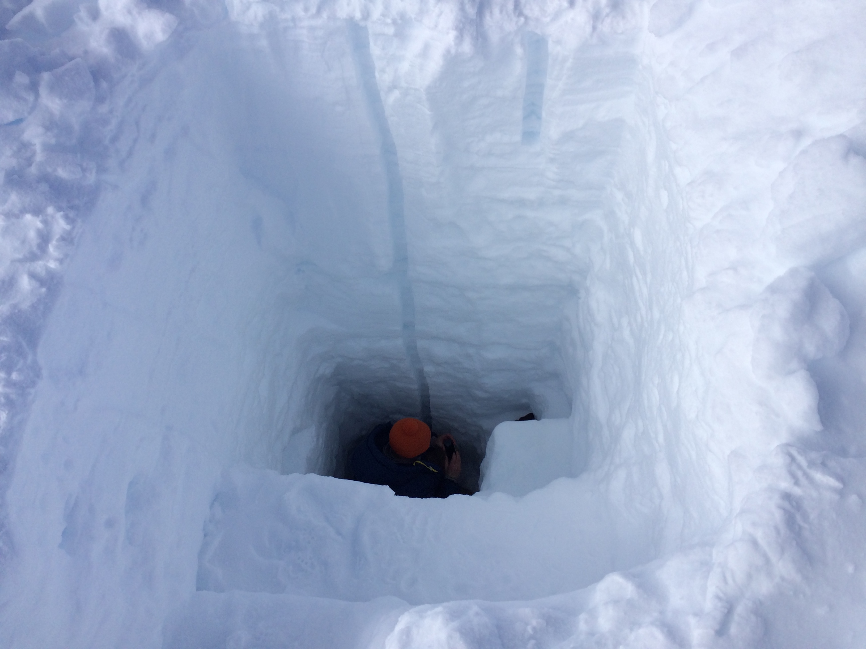
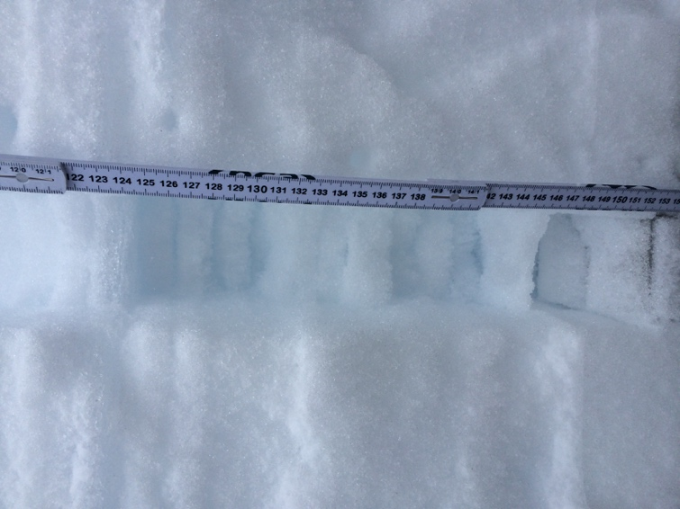
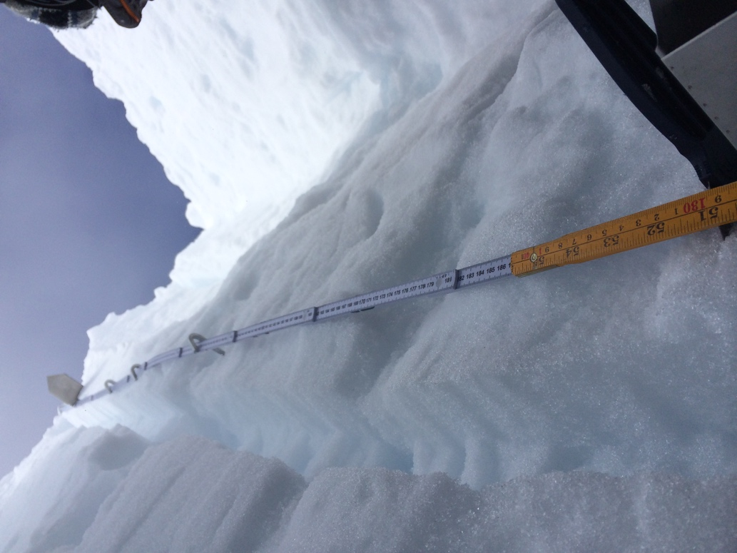
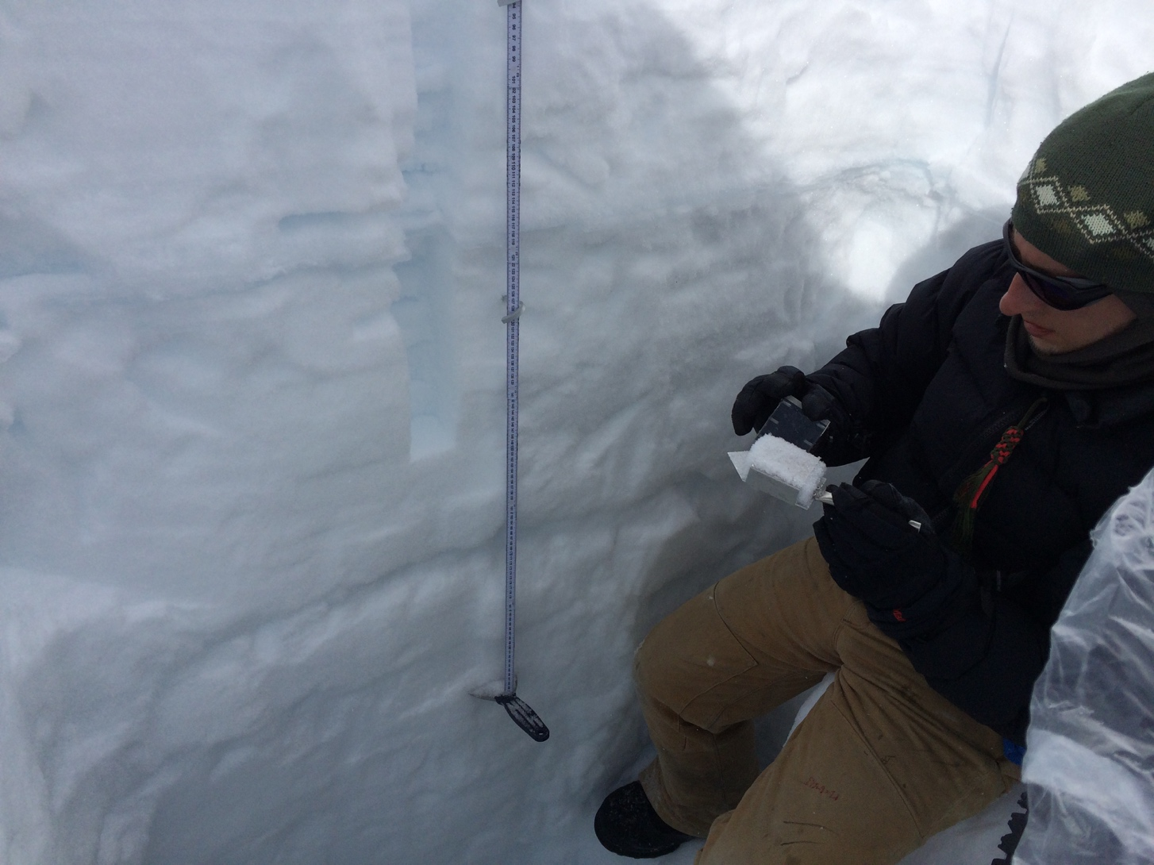
3.5 m snow pit at North Drill
5 km northwest of Summit, July 2014
2012 melt layer
Melt layer somewhere around here…

Slide 3
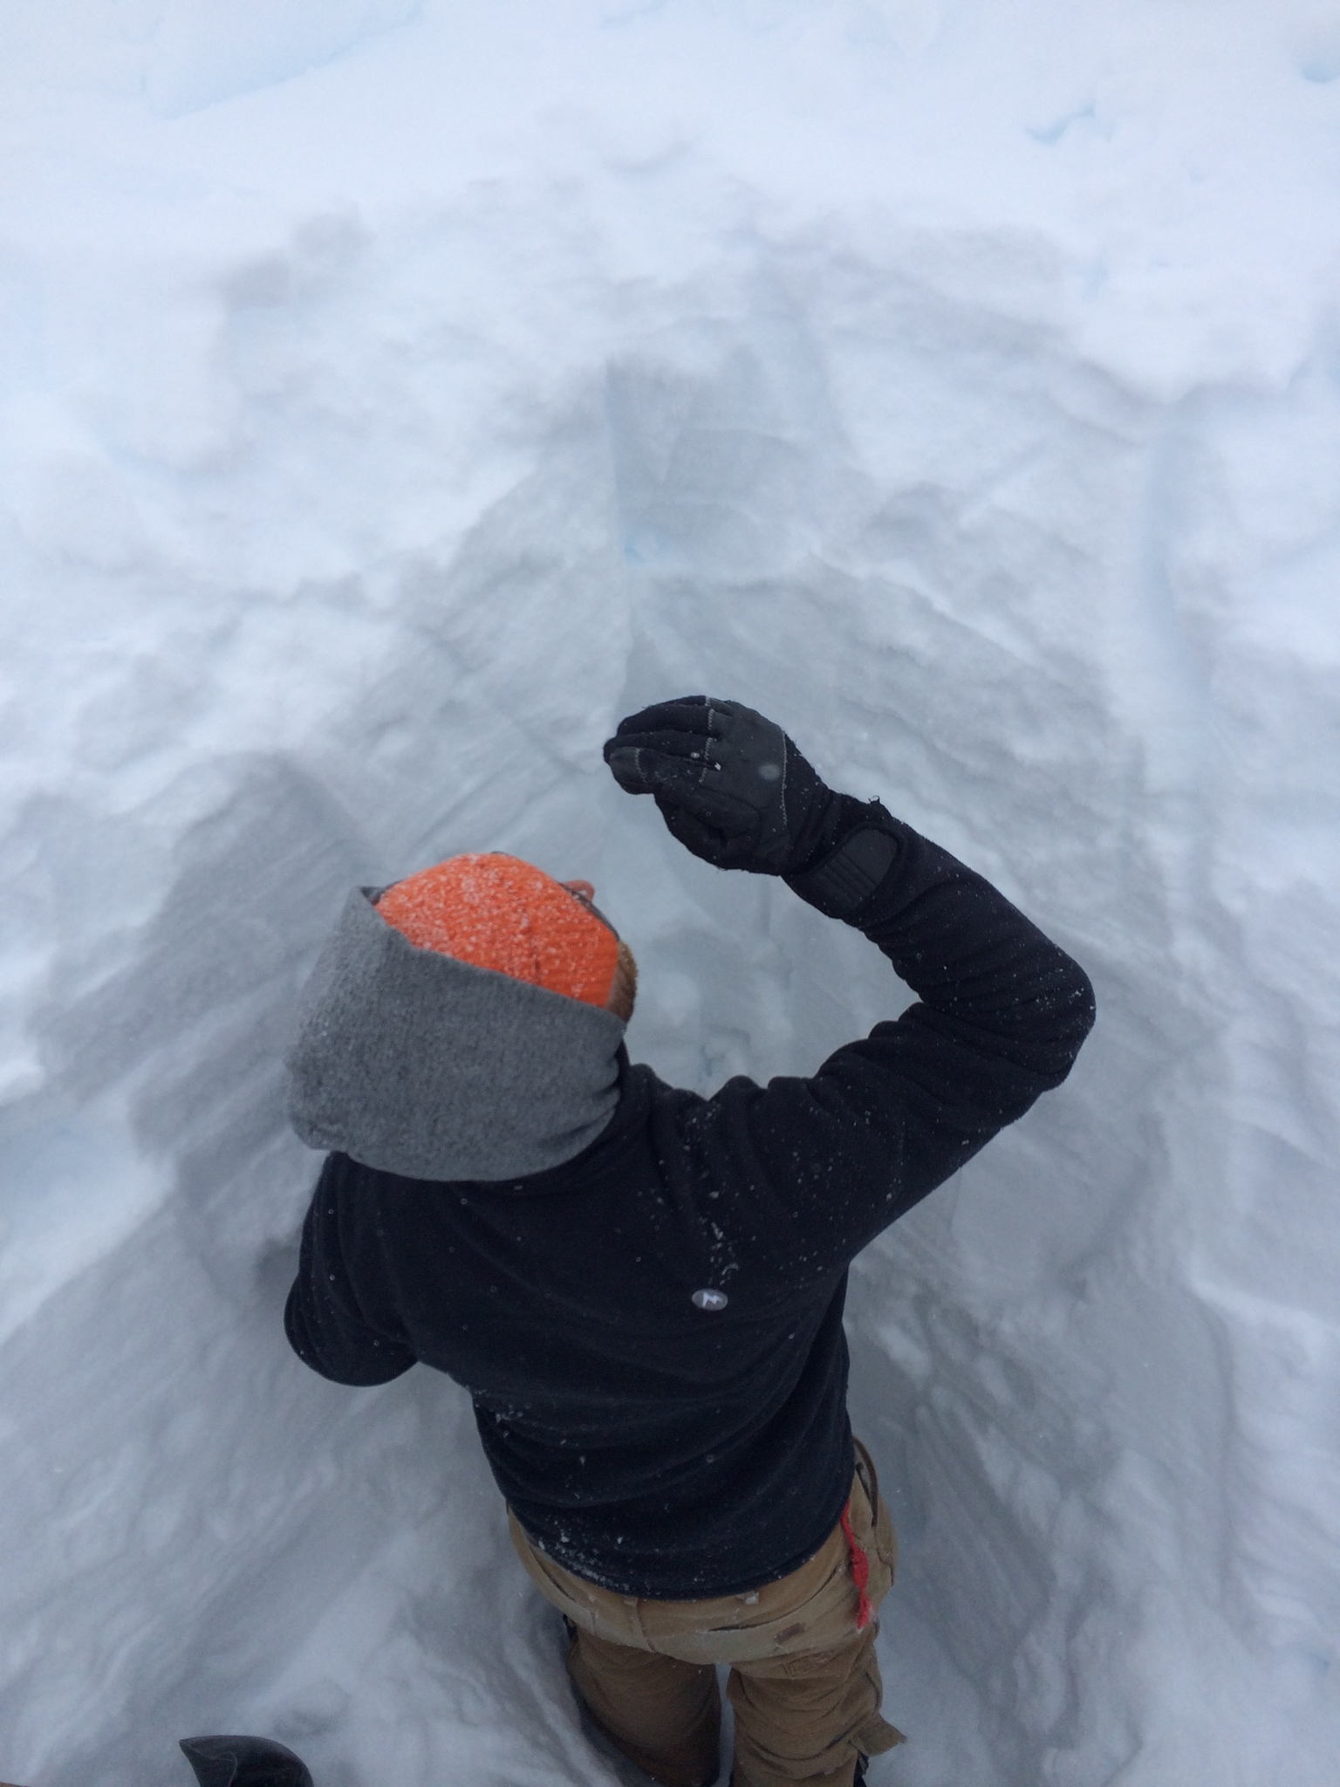
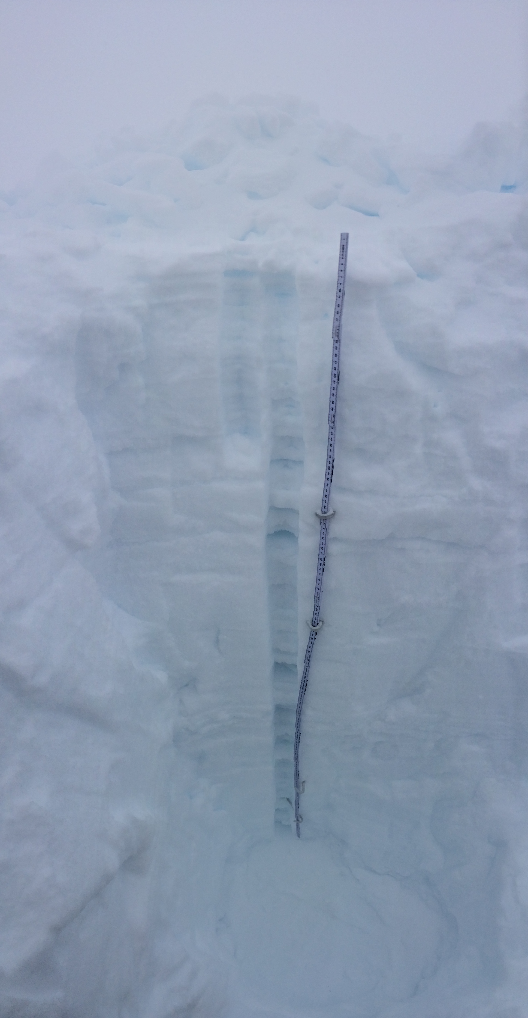
2 m snow pit at TAWO
Summit, July 2014
Max starts to clean one side of the pit so we can sample.
Defining the “surface” is inexact…
This one was tougher to manage: windy and snowy as we worked
Had to make a wall around the pit to keep it from filling in
Much new snow on top made it very diffucult to define 0 cm depth

Slide 4
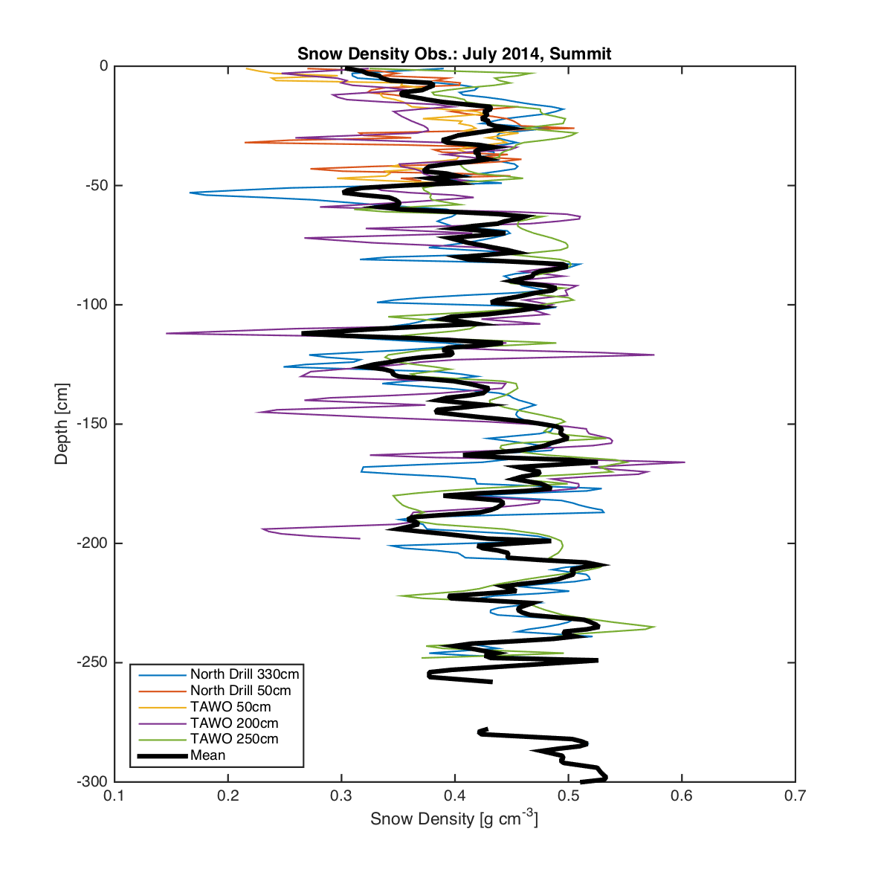
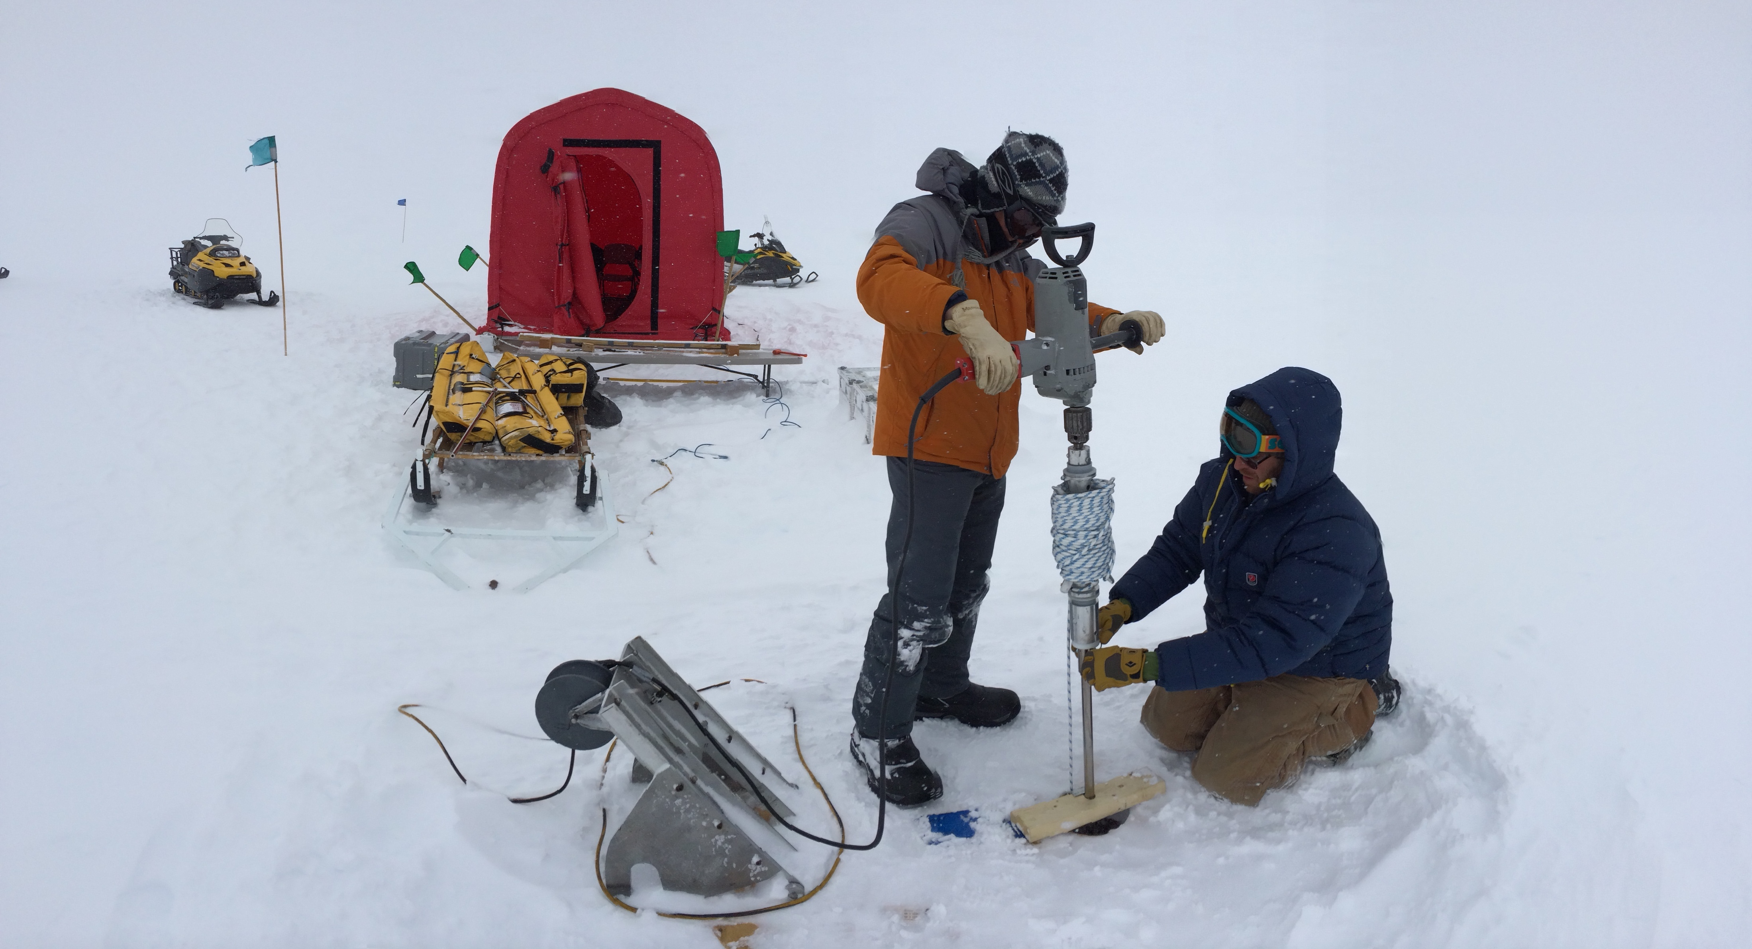
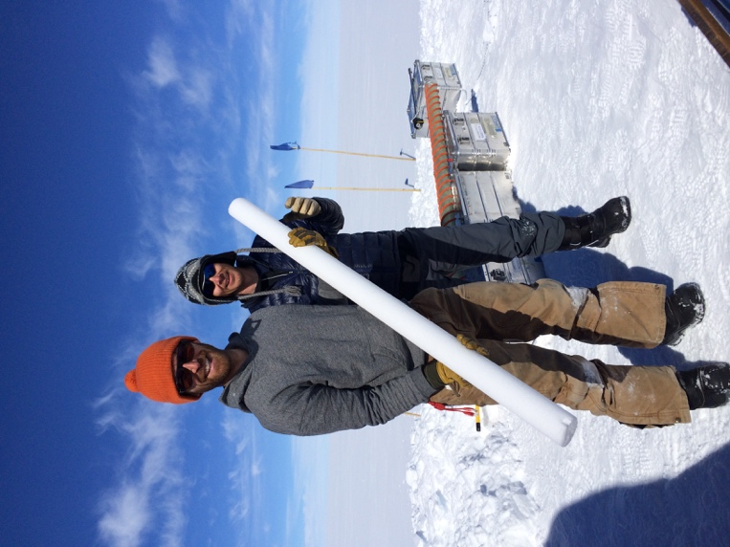
Snow Pit Results
43.2 m North Drill core
(data close to surface less accurate because the coring requires consolidated material. snow pits to be used to supplement first few meters.)

